Slide 1
Week 1: File-system limitations
We can use text files for many applications: they’re efficient, easy to manipulate, and easy to incorporate into software workflows
But they are limited in their applications for several reasons:
Data inconsistency: duplication of information in multiple locations creates a risk that data stored in different locations may be inconsistent
Data fragmentation: changes to data in one location may not propagate to files elsewhere on the system(s)
Platform dependence: system can be highly dependent on directory structure, network settings, operating-system incompatibilities, etc
Lack of standardization / data validation: there is no natural protection against the entry of invalid values that are of an incorrect type, missing, or otherwise erroneous
Inefficient because queries on the data must be customized and aware of the file structure
Also inefficient because data retrieval from large files can be slow
Security: different user access levels can be extremely difficult to manage

Slide 2
Week 1: (Databases)
Databases consist of two components:
Data are “facts” that are accessible to some users
Metadata are information about those data: rules, constraints, etc, that are specified by the user
Databases are implemented via DATABASE MANAGEMENT SYSTEMS (DBMS)

Slide 3
Week 1: Data, Information, and Knowledge
These refer to different levels of interpretation of “facts”
DATA: “Raw facts, or facts that have not yet been processed to reveal their meaning to the end user”. Examples include temperatures, weights, and prices
INFORMATION: “The result of processing raw data to reveal its meaning” Examples include percentages, rankings, and other quantities that depend on comparisons to give context
KNOWLEDGE: “The body of information and facts about a specific subject.” Examples include the body of information pertaining to energy production and usage in Nicaragua. Knowledge can be used to support decision making

Slide 4
Week 1: Types of Data
Unstructured: raw data that has not been interpreted. For example, what is 8028675309? What is 1/1/01? What is this long string of text?
Structured: data that have been assigned an interpretation. For example, (802) 867-5309 is a phone number, 1/1/01 is a date in some format
Semi-structured: data with structured and semi-structured aspects. For example, an email includes headers with structured data about routing, date, etc., but also contains free text that can be considered as unstructured data

Slide 5
Week 1: Database structure
There is conflicting terminology
At the table level: “entities” are rows and “attributes” are columns. “Table” and “relation” are synonymous terms
At the conceptual level: entities are different types of objects or concepts (train, trainwreck, etc)
Relations are connected by relationships (which we will see in Week 4)

Slide 6
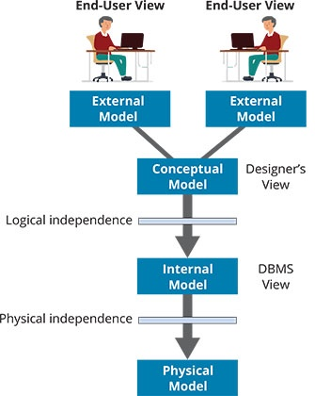
Week 1: Models and Views
External model: the end-user’s view of the data environment
Conceptual model: produced by the conceptual design process, provides a global view of the database without details
Conceptual entities and relationships, but no attribute names, keys, or datatypes
Internal model: A representation that includes DBMS-specific details. Includes tables (including tables that may not have an attached concept, e.g. linker tables), attributes, keys, and datatypes
Physical model: concerned with location and format of data on a specific system

Slide 7
Week 1: DBMS
DBMS: A collection of programs that manages the database structure and controls access to the database. Gives us:
Physical data independence: we don’t need to define / worry about where data or stored or how they are organized
Enforcement of data and metadata standards: data are checked and validated as they are entered
Access control / security
Preservation of data integrity: changes in one part of the DB are reflected elsewhere
Data definition language to define the rules surrounding the data (e.g. tables, constraints, relationships)
Data manipulation language to allow us to modify and view the data in a database

Slide 8
Week 2: DDL and DML
Data Definition Language: Create, modify, and drop tables (and the attributes they contain), and establish relationships between tables
Data Manipulation Language: Insert, update, and delete data in a table, and retrieve the data. Also referred to as CRUD (create, retrieve, update, and delete)
SQL (Structured Query Language) is the most widely used DDL/DML
SQL is a DECLARATIVE language, focused on WHAT you want rather than HOW to get what you want. For example, we do not need a loop to retrieve all rows from a table.
SQL has a frequently updated ANSI standard, but no one adheres to it perfectly. We will use MySQL-specific syntax and structure in this course.

Slide 9
Week 2: SELECT
-- The query structure we will start with
SELECT columns
FROM table
WHERE criteria
ORDER BY column_name
LIMIT max_rows;
SELECT does not modify data in the table, it merely returns it

Slide 10
Week 2: WHERE
Restrict the rows returned to a subset that satisfy one or more criteria you specify
Comparison operators: =, >, <, <=, >=, <>, !=, BETWEEN, LIKE
Logical operators: AND, OR, NOT
Set operator: IN
Defined: IS [NOT] NULL

Slide 11
Week 2: Dependencies
DETERMINANT: "Any attribute whose values in a specific row directly determine other values in the row."
DEPENDENT: "An attribute whose value is determined by another attribute."
Determinant
Dependent
country_name
continent_name
This is a dependency diagram

Slide 12
Week 2: Keys
Key: One or more attributes that determine other attributes. Keys ensure unique identification of records within a specific table.
Superkey: One or more attributes that uniquely identify each row in a table. Superkeys do not need to be minimal.
Candidate key: Like a superkey, but MUST be minimal: removal of any attribute from a candidate key makes it no longer a key
Primary key: A candidate key that is selected to be the unique identifier of each row.
Alternate key: Any candidate key not chosen as primary

Slide 13
Week 2: Keys Continued
Entity Integrity: “The property of a relational table that guarantees each entity has a unique value in a primary key and that the key has no null values”.
The primary key is defined and unique for every entity. Querying on a specific value of the primary key will not return more than one result.
NULLs are absent attribute values. They may be missing from the database, unknown, or undefined.

Slide 14
Week 2: DDL Statements
CREATE / USE / DROP database
CREATE / ALTER / DROP table
Define attributes and datatypes
Define constraints at the attribute (NOT NULL, DEFAULT, CHECK, UNIQUE, etc) or table (PRIMARY KEY, etc) level

Slide 15
Week 2: DML statements other than SELECT
INSERT INTO / UPDATE / DELETE FROM
Must respect constraints of the database, e.g. cannot INSERT or UPDATE to a duplicate value of a primary key
IGNORE keyword rejects invalid operations, but allows execution to continue (otherwise we get an error)
MySQL’s safe mode requires us to reference the primary key when we do an UPDATE or DELETE FROM operation

Slide 16
Week 3: Grouping and Aggregation
SELECT colname1, colname2, colname1 – colname2
FROM tablename
WHERE more conditions
GROUP BY criterion
HAVING criterion
ORDER BY criterion
LIMIT row_count
Part 2: Derived attributes
Part 1: Filtering with LIKE
Part 3: Aggregate and grouping functions

Slide 17
Week 3: The LIKE Condition
Use in WHERE clause to filter text results using wildcards
%: match zero or more characters of any type
_: match exactly one character of any type
e.g., return all rows in `cities` where the city name starts with “A” and is of any length:
SELECT * FROM cities
WHERE city_name LIKE "A%";

Slide 18
Week 3: Derived attributes
You can generate data in your SELECT query that combines information in your database, and use aliases for any columns you return:
You can SELECT constant values, use mathematical operators, as well as functions such as ROUND() and CONCAT()
-- Density is population divided by land area
SELECT city_name, country_name,
city_population, land_area_sq_km,
city_population / land_area_sq_km AS density
FROM cities
WHERE continent_name = "Asia";

Slide 19
Week 3: Aggregation
Return values that summarize one or more rows in a table
Includes COUNT, MAX, MIN, SUM, AVG
Powerful, but we cannot use a single SELECT query that retrieves both row-specific and aggregated information
Aggregation ignores NULLs

Slide 20
Week 3: Grouping
GROUP BY allows us to generate summaries based on categories we define in our database
Attributes we use to group by can be used in SELECT:
GROUP BY puts NULLs into their own separate group
HAVING: Filter results based on values produced in the GROUP BY clause
-- What is the average year cities were founded by continent?
SELECT continent_name, AVG(year_founded)
FROM cities
GROUP BY continent_name;

Slide 21
Week 4: Foreign Keys
Foreign keys are used to establish relationships between entities (=tables), ensuring referential integrity: A condition by which a dependent table’s foreign key entry must have either a null entry, or a matching entry in the primary key of the related table.
A foreign key in a dependent table references the primary key of a parent table. Values of the foreign key must be present in the referenced primary key, or be NULL. An operation will fail if:
It tries to create a foreign-key value (via INSERT or UPDATE) that is not present in the PK of the parent table
It tries to change a value in the PK of the parent table that is present in the foreign key in the dependent table

Slide 22
Week 4: Dealing with multi-valued attributes
A multi-valued attribute is simply any attribute that takes on multiple values in a database. But there can be challenges in finding the best way to deal with these.
If a single attribute of one type (e.g., language name) maps to many values of another (e.g., countries in which that language is official) then we need to find an appropriate representation
A simple way to do this is to combine them into a single row:
But this makes it very difficult to access and modify specific values of this attribute

Slide 23
Week 4: Dealing with multi-valued attributes cont’d
We can instead split our multiple values across rows, with each row containing a unique combination of attribute 1 and attribute 2 (a composite primary key)
Doing so gives us atomic attributes, which can be used for grouping and other database operations. It is also an essential element of first normal form
However, doing this can create a lot of redundancy (and prevents us from setting the official language to NULL since it’s now a part of the primary key).

Slide 24
Week 4: The solution: create a new table
Instead of trying to awkwardly make this work in a single table, we can create another table and link the two tables together using a foreign key.

Slide 25
Week 4: Database modeling
Key steps:
Identify business rules
Build the conceptual model
Construct the internal model
Build the database
This is an iterative process that requires frequent testing and revision

Slide 26
Week 4: Business Rules
A description that defines certain relationships and/or imposes some constraints on the data
(Textbook definition: “A description of a policy, procedure, or principle within an organization.”)
A good business rule clearly communicates conceptual entities, relationships, and the cardinality and optionality of these relationships
Cardinality: the number of instances of one entity that can map to the other (e.g., many to many)
Optionality: whether 1 or more instances of one entity can map to zero instances of the other

Slide 27
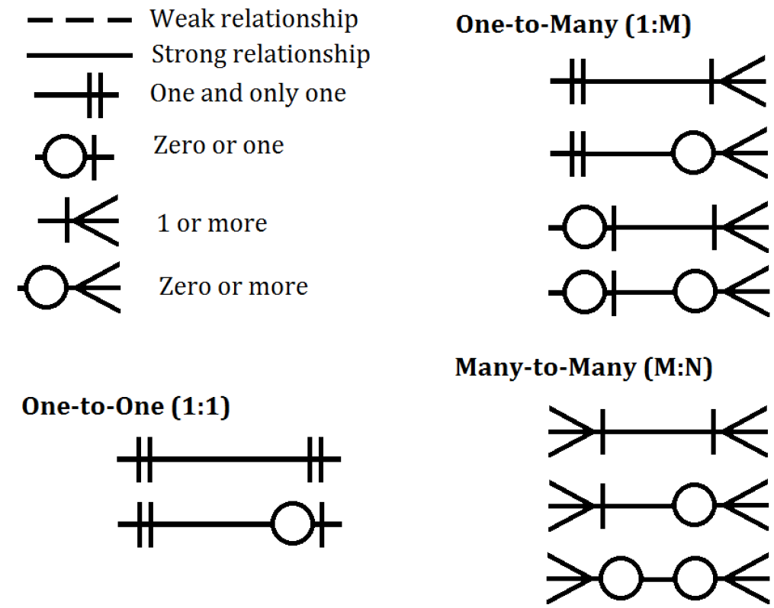
Week 4: Entity-Relationship Diagrams
E-R diagrams can have many different formats (do a Google search to see this)
They can be used to represent the conceptual or internal model
Conceptual E-R diagrams show conceptual entities, cardinality and optionality of relationships, and strong/weak dependencies
We use Crow’s Foot notation in class
Existence dependence: one conceptual entity cannot exist without another
In DB terms, this corresponds to cases where the primary key of the dependent table is also the primary key of the parent table

Slide 28
Week 4: E-R Diagrams Part 2
What is shown in E-R diagrams?
Conceptual: conceptual entities, relationships
Logical: table structure, attributes, keys, relationships (we’re not using this)
Internal: table structure, attributes, keys, datatypes, relationships

Slide 29
Week 4: Many-to-Many Relationships
These are difficult to model in a single table
You can try to do it using comma-separated lists…not good
You can have composite primary keys in a single large table…also potentially not good
A common solution is to use a linker table to mediate the many-to-many relationship
The linker table has a composite primary key. Each component of this primary key is also a foreign key that points to one of the parent tables

Slide 30
Week 5: Table Aliases
-- Select three columns, use a table alias
SELECT
lang.language_name,
lang.language_family,
lang.num_speakers
FROM languages lang
WHERE lang.num_speakers > 1000000
ORDER BY lang.num_speakers DESC;

Slide 31
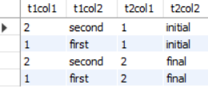


Week 5: CROSS JOIN
Combine every row of Table 1 with every row of Table 2
Yields the Cartesian product
Can be restricted with WHERE clauses
SELECT * FROM table1 CROSS JOIN table2
table1 CROSS JOIN table2
table1
table2
×

Slide 32
Week 5: INNER JOIN
Every row x every row, restricted to matching criteria
Joining criteria can be specified with:
USING – Column must be shared between two tables, joining column appears first in the joined table
ON – Column names must be specified
Columns with the same name in both tables must be referenced with table name or alias

Slide 33
Week 5: NATURAL JOIN
Like INNER JOIN…USING(), applied automatically to all column names shared between the two tables
No shared columns: Cartesian product is returned (like CROSS JOIN)

Slide 34
Week 5: OUTER JOIN
Return every combination of rows, restricted using the JOIN condition, plus all rows that have no match:
LEFT OUTER JOIN: All rows in T₁ that do not match T₂
RIGHT OUTER JOIN: All rows in T₂ that do not match T₁
FULL OUTER JOIN: Both sets of rows (not implemented in MySQL)

Slide 35
Week 5: Self Joins
Join a table with itself
Can be done with any JOIN operation
Must use table aliases to distinguish the two versions of the table being joined

Slide 36
Summary
INNER JOIN USING
NATURAL JOIN
INNER JOIN
INNER JOIN ON
CROSS JOIN
LEFT OUTER JOIN
OUTER JOIN
RIGHT OUTER JOIN
FULL OUTER JOIN*

Slide 37
Week 6: Normalization
"A process that assigns attributes to entities so that data redundancies are reduced or eliminated."
Different levels of normalization with increasing levels of stringency
We cover the first three

Slide 38
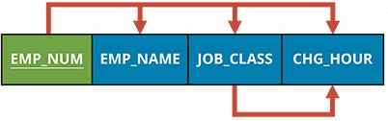
Week 6: Dependency Diagrams
Dependencies: EMP_NUM determines EMP_NAME
Arrows above: good
Arrows below: not good
(in principle)
Other attributes
Primary key: underlined and distinguished by colour

Slide 39
Week 6: First Normal Form
A database is in 1NF if it has the following properties:
Atomic values: a given cell must not contain multiple values (arrays, sets, etc)
Uniqueness: No duplicate rows (enforced with a primary key), no repeated columns
Order independence: The order of rows and columns is unimportant for data integrity
Consistent data type: All instances of a given attribute must have a consistent datatype
#3 and #4 are enforced by the DBMS

Slide 40
Week 6: Second Normal Form
A table is in second normal form if:
It is in first normal form, and
It contains no partial dependencies
A partial dependency is when a nonkey attribute depends on only one part P of a composite key attribute
To put a table in 2NF, move all attributes that depend only on P into a new table, and make P the primary key of that table

Slide 41
Week 6: Third Normal Form
A table is in third normal form if:
It is in second normal form, and
It contains no transitive dependencies
A transitive dependency is when a nonkey attribute depends on another nonkey attribute
To put a table in 3NF, move the nonkey attributes in the transitive relationship to a new table, with the determinant of the transitive dependency as the primary key.

Slide 42
Week 6: Advantages and Disadvantages of Normalization
Advantages of normalization:
Less redundancy
Fewer anomalies
Conceptual clarity
Disadvantages of normalization:
Data fragmentation
Computational cost
Joins, joins, joins!

Slide 43
Week 8: Relational Set Operators
Combine the results of two queries using an operator term:
UNION: combine the two queries, removing redundancy (unless you use UNION ALL)
INTERSECT: return only those rows returned by both queries
EXCEPT: return only those rows from the first query that are absent from the second
Both queries must return the same number of attributes
Attributes must have the same data type (or be CASTable)

Slide 44
Subqueries
A query that is executed as part of another query.
The inner query is executed first, followed by the outer query
These are useful when you need to generate intermediate results (for example, if you are trying to take the MAX of average values from a table) before completing the query
Typically enclosed in parentheses

Slide 45
Subqueries in Different Clauses
WHERE and HAVING clauses – must produce a single value for comparative purposes (if doing a comparison like ‘>’) or a list (if using IN() for a filtering criterion)
FROM – inner query produces an intermediate table that can be referenced in the FROM clause. This table can be treated as any other (for example, it can be JOINed to other tables) but it must have an alias
SELECT – produce single values to return as results or perform comparisons (for example, subtracting the AVG() from a column from individual values)

Slide 46
Common Table Expressions
Can be used in a similar way to subqueries, but CTEs are a good way to separate query logic to make it clearer, and avoid the need to duplicate text within a query
CTE:
WITH cte_name AS (query)
SELECT …
CTEs must be SELECTed from, they cannot be referenced simply by name

Slide 47
“Persistent Data Objects”
Basic DML statements, subqueries, and CTEs are all restricted to the current query – they cannot be re-used in other queries
Consequently we may need to duplicate query text in multiple places, which is difficult to maintain
Persistent data objects include user-defined variables, tables created from SELECT statement, and views, all of which are not restricted to a single query
“Persistent data objects” is not a standard term, but a useful grouping of structures based on a shared property of persistence

Slide 48
User-Defined Variables
Variables are scalars: they can hold only a single variable
They are referenced using ‘@’ in the main execution environment (different from procedural objects such as stored procedures) and their names are case-insensitive
They can be assigned to using SET @varname := value or SET @varname = value
They can also be assigned a value from a SELECT statement (as long as the SELECT statement returns only a single value)

Slide 49
CREATE TABLE SELECT…
Generate a new table from the results of a SELECT statement
This can be useful to store aggregated values and avoid the need to re-run expensive operations such as table JOINs
The new table generally inherits column-level properties and constraints but not table-level constraints such as primary keys and foreign keys
But we can specify these constraints when we create the table, or apply them later when we execute ALTER TABLE
Not great from a normalization / anomaly standpoint since they create redundancies

Slide 50
Temporary Tables
Like regular database tables, but they persist only for the current database session, and are discarded after the user disconnects
Data is duplicated as it is in a regular table created from a SELECT query, but the time-limited persistence of temporary tables reduces the risk of anomalies
Great for storing temporary results

Slide 51
Views
A virtual table created from a SELECT query
CREATE VIEW view_name AS (SELECT…)
The table itself is not stored, instead the query that was used to create the view is re-run every time the view is referenced
DDL statements on the underlying tables can corrupt the view
Minimize the risk of anomalies relative to creating new tables, but re-running the query that generated the view can be very inefficient

Slide 52
 | Persistent? | Nested? | Static?
Relational Set Operators | No | No | N/A
Subqueries | No | Yes | N/A
Common Table Expressions | No | Yes | N/A
Variables | Yes | *** | Yes
CREATE TABLE SELECT | Yes | *** | Yes
Views | "Yes" (in memory) | *** | No
*** Can be constructed using nested subqueries / CTEs

Slide 53
Week 9: Reminder
We’re getting into very DBMS-specific territory! MySQL is again our focus, but if you’re using a different DBMS you will need to take a careful look at what is implemented and how

Slide 54
Week 9: Datatypes
Integer types: Many sizes with different storage requirements
Fixed-point decimal datatypes: always constrained to a fixed number of digits (e.g., DECIMAL(5,2) is five digits total, max two after the decimal point)
Floating-point decimal datatypes: approximate, can give unexpected results
Character / string datatypes: CHAR() reserves max space, VARCHAR() uses only as much space as necessary, TEXT can be larger but is less efficient

Slide 55
Week 9: Dates and Times
DATE: yyyy-mm-dd
TIME: hh:mm:ss[.fraction]
'-838:59:59.000000' to '838:59:59.000000'
DATETIME: yyyy-mm-dd hh:mm:ss[.fraction]
TIMESTAMP: Like DATETIME, but:
Lesser range (1970-2038 as opposed to 1000-9999)
Different storage requirements and time-zone handling

Slide 56
Week 9: Built-in Functions
RAND(): generate a random number between 0 and 1. Can use RAND(seed) to generate reproducible random numbers
STRCMP(string1, string2): Compare two strings, return -1 / 0 / 1 if string1 is less than / equal to / greater than string2
TIMEDIFF(time1, time2): Return the time difference between time1 and time2 (which will be negative if time2 > time1)
CONCAT(str1, str2, str3): merge the strings provided into a single object
CAST(item AS datatype): convert the format of item to datatype if possible

Slide 57
Week 9: DDL Summary
ON UPDATE [CASCADE | SET NULL | SET DEFAULT | NO ACTION]
Applied to a foreign key in a table
When a primary key value in the parent table is changed, what happens to all corresponding values in the foreign key:
CASCADE: changes in the PK propagate to the FK
SET NULL / SET DEFAULT: assign the specified value to any impacted FK instances
NO ACTION: prohibit the update (this is implicitly the default)

Slide 58
Week 10: Procedural SQL
SQL is a declarative language, but sometimes we need to run several statements in succession (i.e., procedural code)
Extensions to SQL allow us to do this. Sometimes these extensions have a specific name (e.g., PL/SQL in Oracle), but they have no specific name in MySQL
Procedural SQL includes:
Transaction control
Procedural objects (stored procedures, user-defined functions, triggers)
Flow control
Other aspects such as error handling that we do not discuss

Slide 59
Week 10: Transaction Control
Normally the unit of transaction in SQL is a single query, which either succeeds or fails
Transactional control allows successive DML queries to be chained together; if one of these statements fails, then all statements in the block can be undone and changes to the database not committed
Some statements (e.g., DDL) cannot be rolled back; behaviour can be DBMS-specific

Slide 60
Week 10: Stored Procedures
A collection of statements that can make changes to the database and user-defined variables
Invoked using CALL() with zero or more variables passed as parameters
Parameters:
IN (values are passed to the stored procedure; changes to parameters are not saved)
OUT (values are not passed to stored procedure; changes to parameters are saved)
INOUT (values are passed to stored procedure; changes to parameters are saved
Local variables:
Declared before procedural statements with DECLARE
Are not preceded with @ inside stored procedures

Slide 61
Week 10: User-Defined Functions
A collection of statements that must return a value
Invoked with the function name and parameters, not CALL()
No transaction control
No modifications to objects outside their scope (UPDATE, DDL, etc)
Requires one of (DETERMINISTIC, NO SQL, READS SQL DATA)

Slide 62
Week 10: Triggers
Defined for a specific DML (INSERT, UPDATE, DELETE) action on a specific table
Invoked automatically, never directly by the user
Operates FOR EACH ROW modified by the triggering statement
Cannot produce output directly
Can reference OLD and NEW attribute values (you can even modify NEW values before they are inserted into the table)
Triggers can be used to maintain database integrity

Slide 63
Week 10: Stored Procedures, Functions, Triggers
 | Stored Procedures | Functions | Triggers
Invoked? | CALL() | Function name | Automatic
Can do DDL? | Yes | No | Yes
Can do SELECT? | Yes | Yes | No
INSERT / UPDATE / DELETE? | Yes | No | Yes
Input parameters? | Yes | Yes | No
Return values? | Via OUT parameters | RETURN | No
Can call? | Procedures, functions | Functions | Procedures, functions
Careful though – some of these are DBMS specific

Slide 64
Week 11: Flow Control
Comprised of conditionals and loops
Can be very useful in procedural objects and simplify queries

Slide 65
Week 11: CASE
CASE expression (sometimes referred to as function): Not procedural!
Series of WHEN…THEN statements determines what value is returned, possibly with terminating ELSE
CASE statement: Procedural!
WHEN…THEN as above, but each condition can lead to the execution of procedural statements (rather than just returning a value)
Syntax is nearly identical, but we need “END CASE;” rather than just “END;”

Slide 66
Week 11: IF
IF statement: execute code depending on the first in a series of conditions that is satisfied
IF…THEN…ELSIF…THEN…ELSE…END IF;
IF function: IF(expr1, expr2, expr3)
Returns expr2 if expr1 is true, otherwise returns expr3

Slide 67
Week 11: Loops
LOOP: Execute the code contained between LOOP and END LOOP
Exit using the LEAVE statement, typically tested using a conditional such as IF
WHILE: Specify a condition, loop continues until that condition is satisfied
LEAVE is not necessary but you can still specify it as a way to short-circuit the loop
LEAVE can also be used to exit BEGIN…END blocks in procedural objects

Slide 68
Week 12: Optimization
Query and database optimization are vital for larger databases
There are many ways to do these optimizations, BUT
The way queries are parsed by the DBMS can be completely different from the way you write them
Changes you make to your queries may have little to no impact if the optimizer is already running them in an efficient way!
Repeated testing is essential!

Slide 69
Week 12: Query Performance
Different clauses in a SELECT statement can impact query performance in different ways:
FROM: Table joins can be very expensive
WHERE: Comparing each row against one or more criteria can take a long time
GROUP BY: Can slow query execution, but can make a huge difference in limiting output rows
ORDER BY: Can be very time consuming on large tables
LIMIT: Can drastically reduce fetch / output time

Slide 70
Week 12: Indexing
Generates an efficient representation of a given attribute (or combination of attributes) using a data structure such as a B-tree
Primary keys are indexed by default
Can greatly improve performance when indexed attributes are used frequently in JOINs, WHERE clauses, etc
But they consume memory and can drastically slow down DML operations (since the index needs to be recalculated)

Slide 71
Week 12: Inefficiencies
Computing derived attributes over and over and over again
Functions such as exponentiation and logarithms
Numeric comparisons are faster than text
One solution to these limitations is to DENORMALIZE the database by precomputing derived attributes (and updating them using triggers where necessary)
Temporary tables can help with this
Views do not save computation time since the recalculation needs to be done every time they are referenced

Slide 72
Week 12: Understanding Query Execution
ANALYZE TABLE: Generate statistics about data distributions in columns, to help the query parser come up with the best execution plan
EXPLAIN query: Show how the parser will execute the query based on keys, joins, and data distributions

Slide 73


